Slide 1
AI Virtual Health Assistant
By Eric Lin
00.00.00

Slide 2

Problem
P A R T 0 1
Patients often struggle to access accurate and personalized health advice quickly. Traditional healthcare systems are overwhelmed, leading to long wait times and limited one-on-one consultation. Moreover, many patients lack access to real-time guidance for their symptoms, making it difficult to make informed health decisions.

Slide 3

Solution
P A R T 0 1
Our AI Virtual Health Assistant provides instant, personalized health guidance using advanced AI models. It can understand user queries, analyze symptoms, and offer accurate health insights. With voice, text, and image input support, it delivers a seamless, accessible healthcare experience anytime, anywhere.

Slide 4
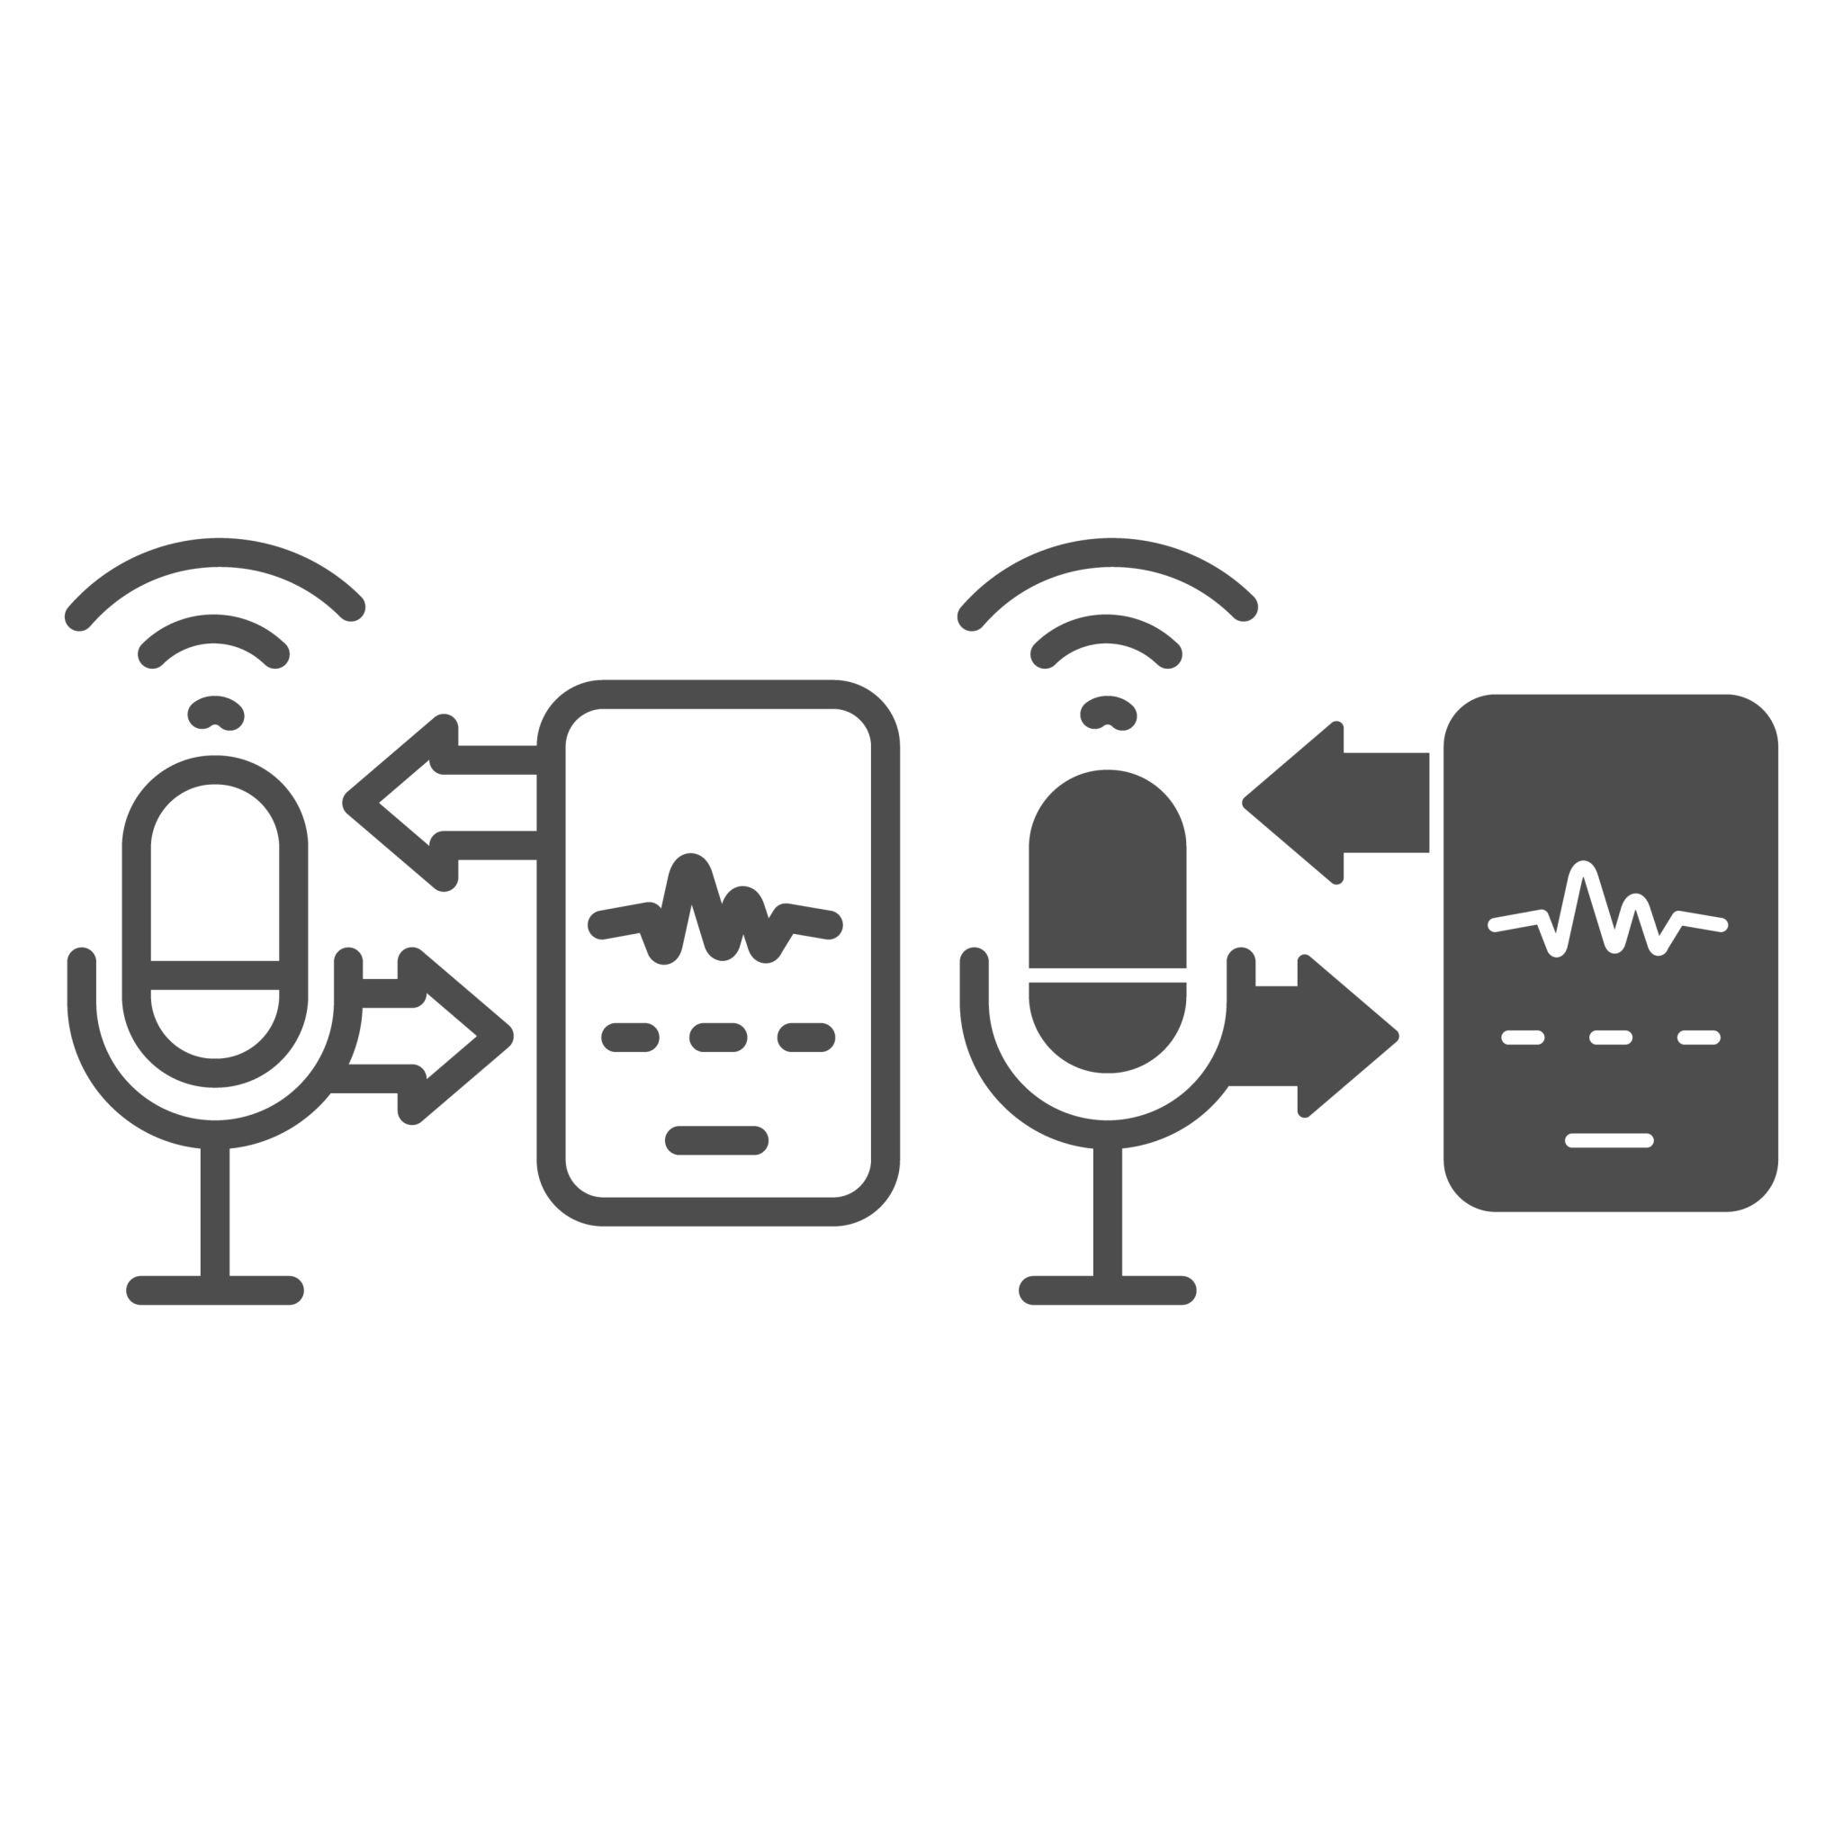
Project Layout
Frontend Workflow
Backend Workflow
User uploads an image, enters text, or records audio.
Frontend sends the image, text, or audio to the API.
API processes the input and returns the response.
The Speaker speaks the message.
API receives the query.
Audio is transcribed (if provided).
Image is encoded and sent with the query to Groq.
Response is generated and returned to the user.

Slide 5
Tools & Technologies
Frontend
Backend
Next.js (React) for UI and routing.
Tailwind CSS for styling.
Sonner for toast notifications.
Next.js API Routes for server-side logic.
Groq SDK for multimodal (text + image) LLM.
Cartesia API for voice synthesis (TTS).
Deployment
Vercel (Recommended for Next.js).
Environment Variables for API keys (Groq, Cartesia).

Slide 6
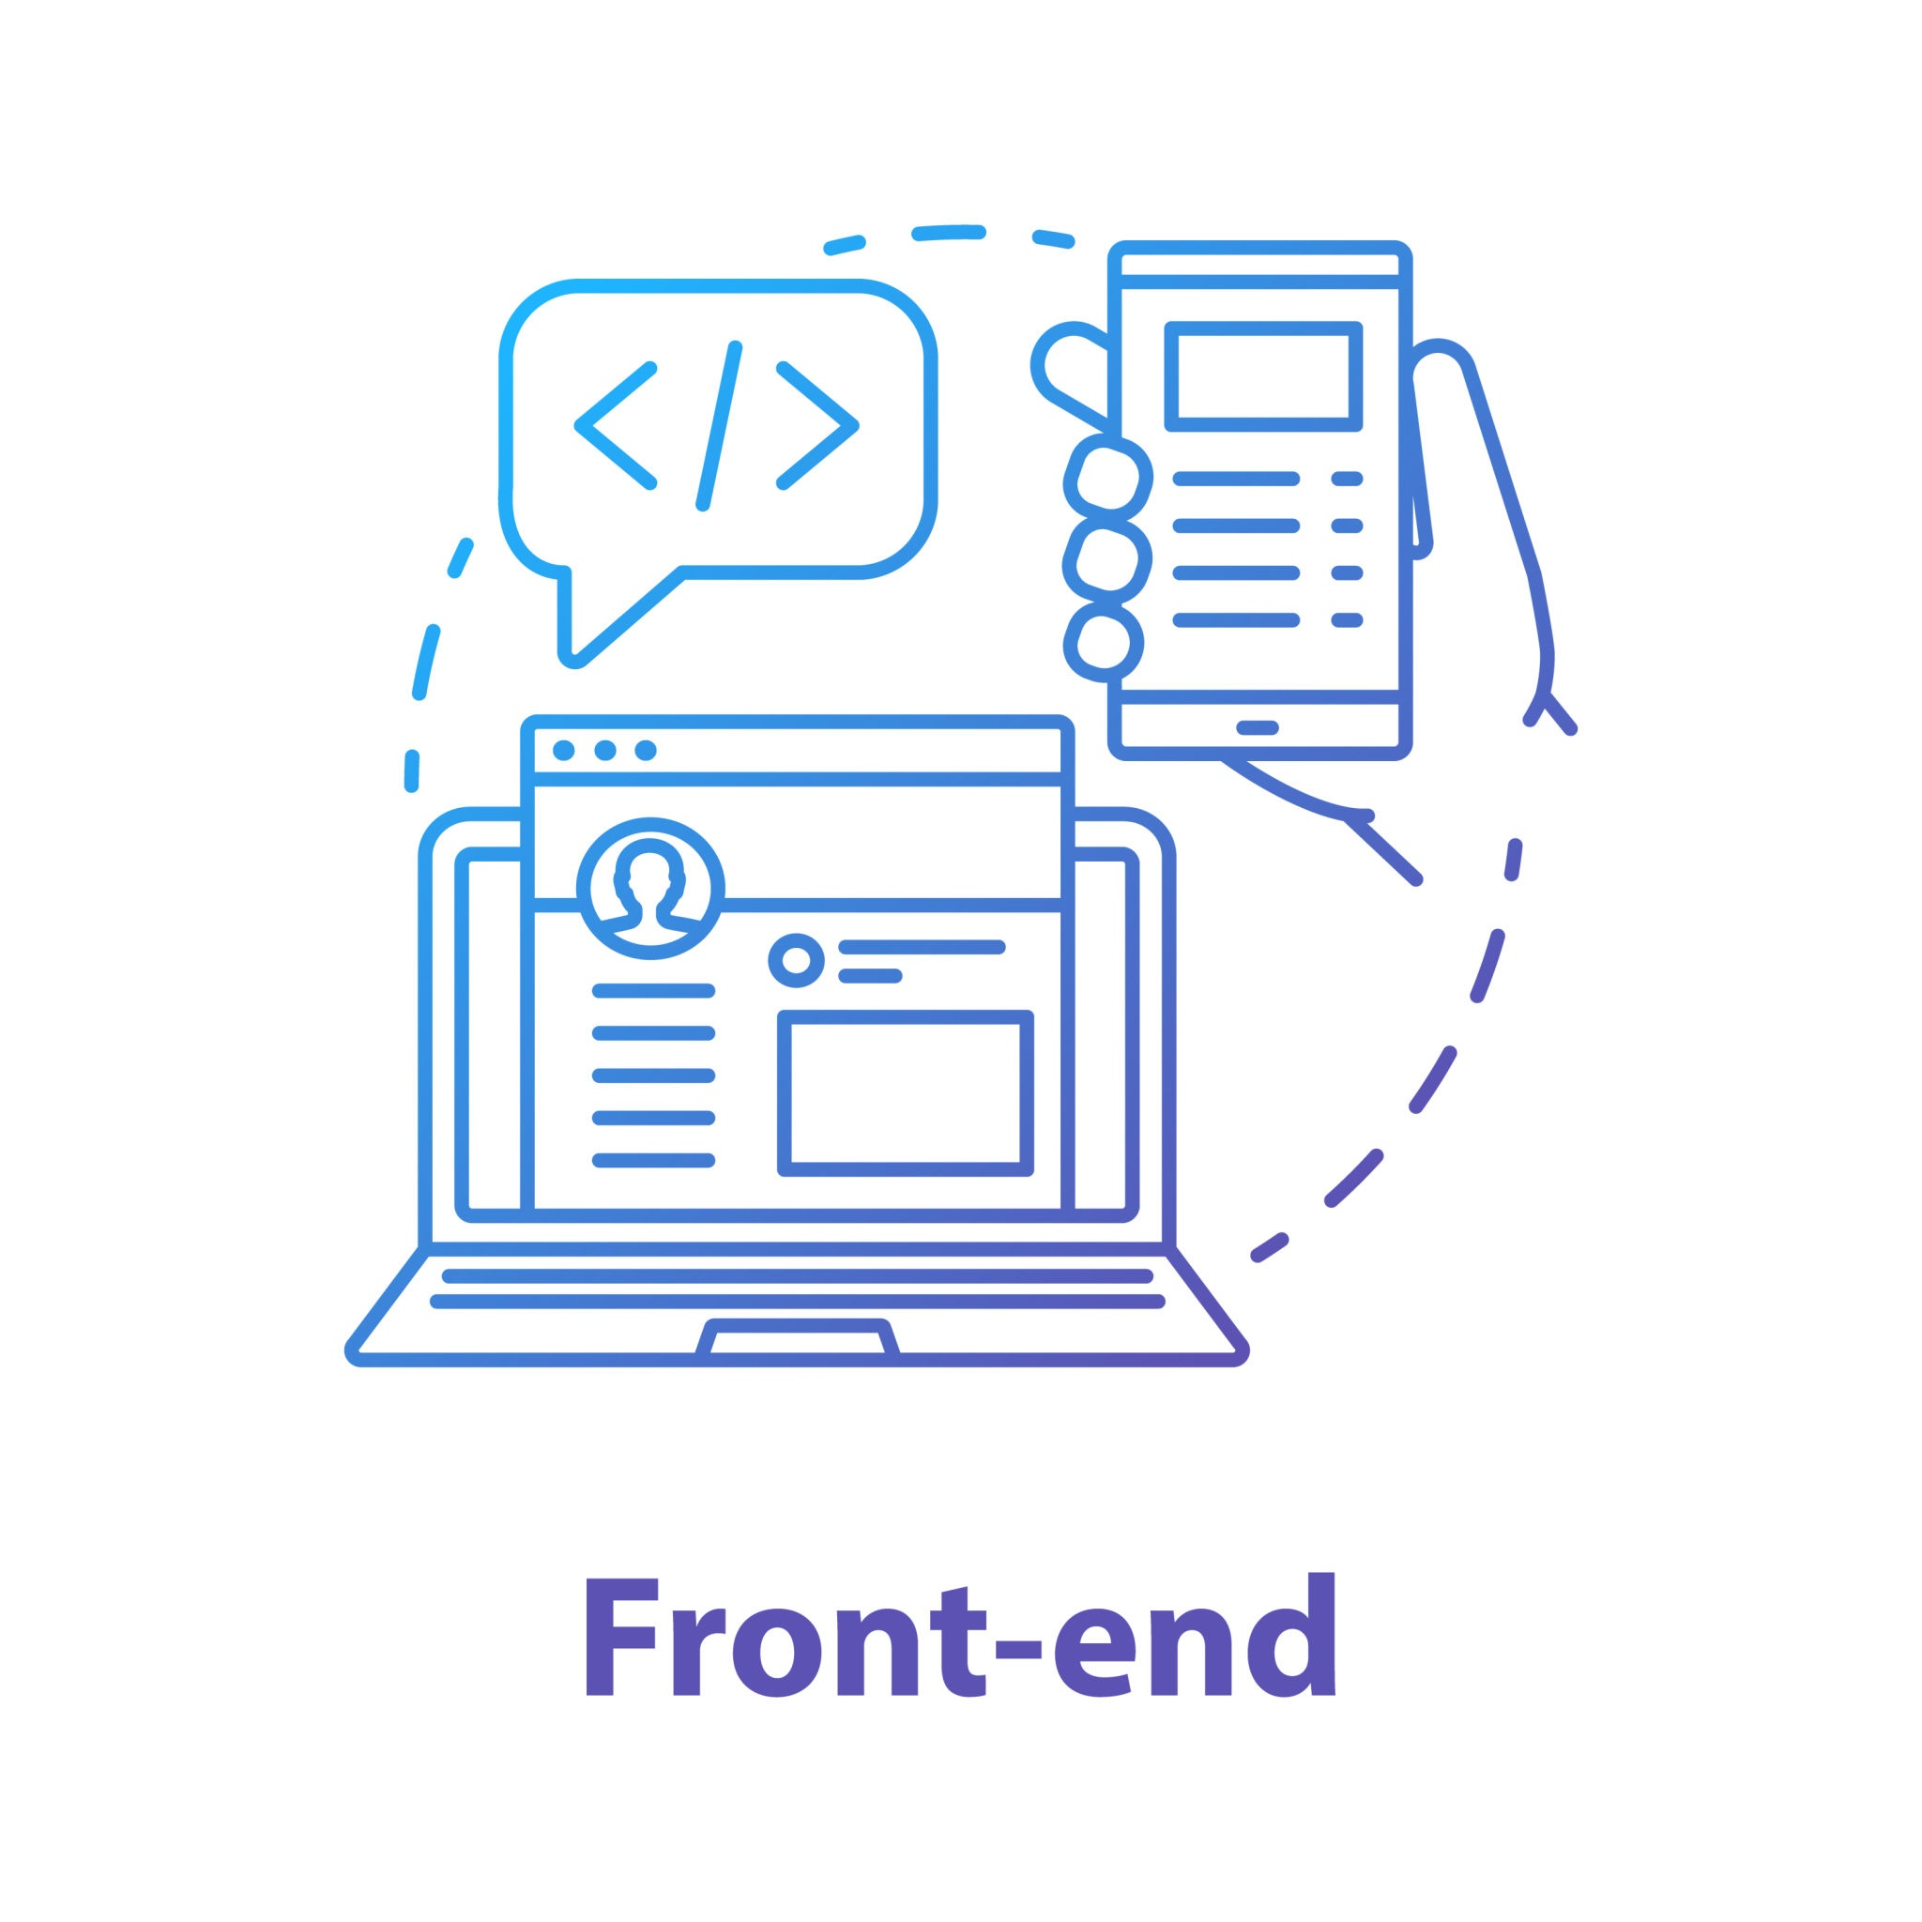
Technical Architecture
Frontend
Backend
React components with state management using useState.
Dynamic handling of image, text, and audio inputs.
Fetch API for server communication.
Next.js API route (app/api/route.ts) with two methods:
POST: Handles user queries (text, image, audio).
GET: Provides call logs for monitoring.
Groq SDK for multimodal LLM queries (text + image).
Cartesia API for text-to-speech (TTS).

Slide 7
Data Flow
P A R T 0 1
User uploads an image, enters text, or records audio.
API handles input:
Text: Directly sent to Groq.
Image: Base64 encoded and sent to Groq.
Audio: Transcribed using Groq (Whisper model).
Groq generates a response using multimodal LLM.
Response is displayed in the UI and played as audio.

Slide 8

Demo: AI Healthcare diagnosis chatbot
P A R T 0 1

Slide 9
Additional Diagnosis Tool
P A R T 0 1
To translate the trained machine learning model into a practical, easy-to-use AI health assistant that can estimate a user's diabetes risk based on their lifestyle and health indicators.

Slide 10
Additional Diagnosis Tool
P A R T 0 1
Translate the trained machine learning model into a practical, easy-to-use AI health assistant that can estimate a user's diabetes risk based on their lifestyle and health indicators.
Built With
Gradio: For creating an interactive web-based interface
XGBoost Classifier: Selected for its strong performance on structured data
Python + Scikit-learn: For preprocessing, training, model evaluation

Slide 11
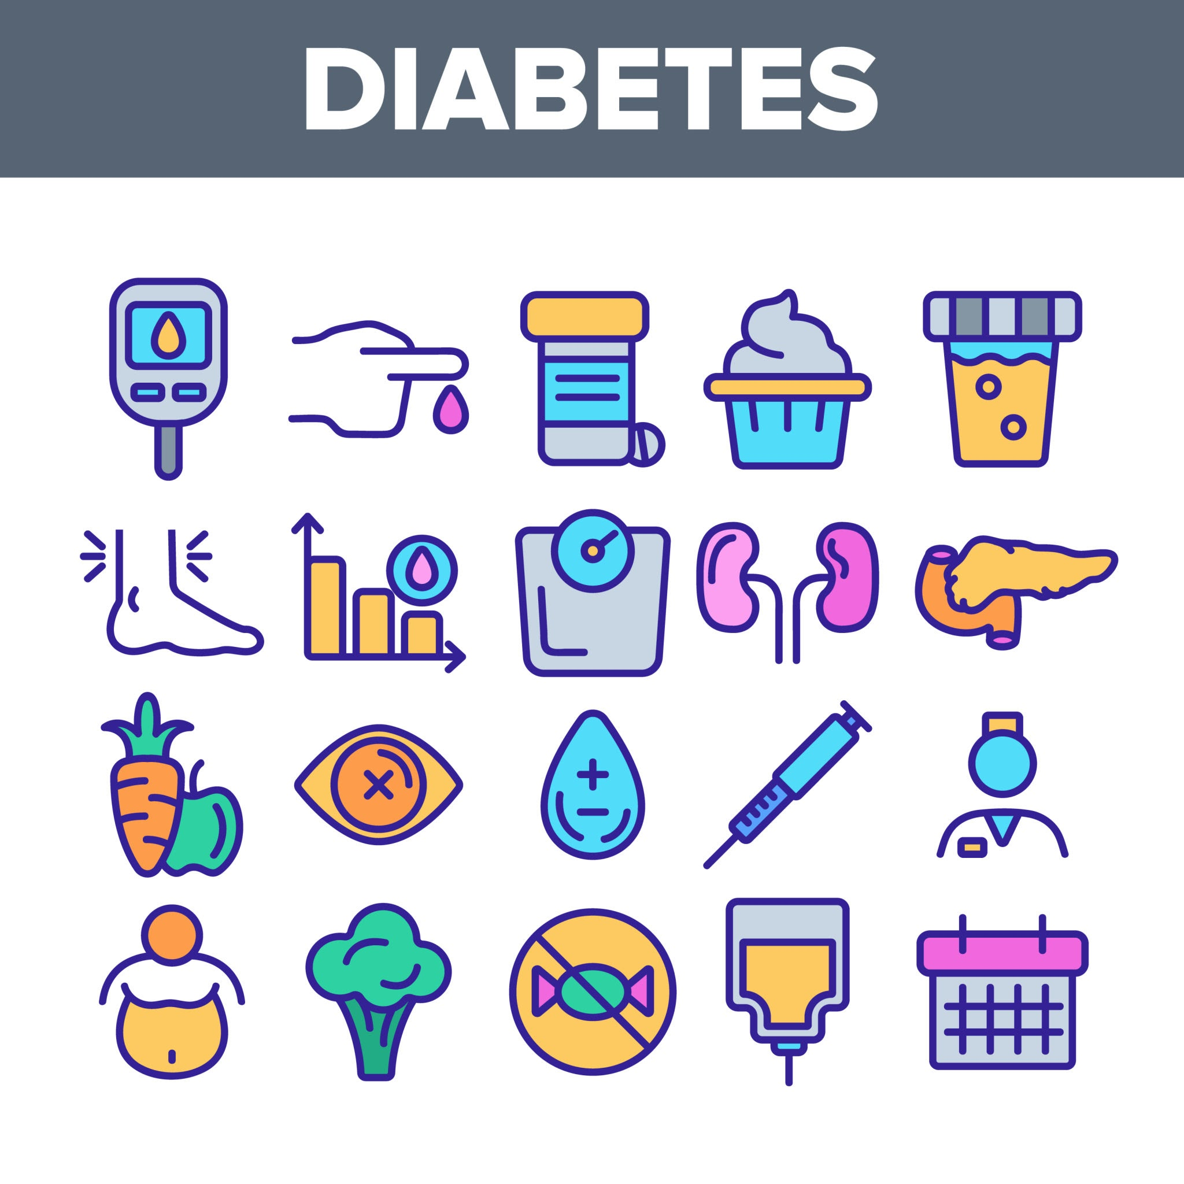
Dataset
CDC Diabetes Health Indicators
UCI Dataset
The dataset contains survey-based health and lifestyle information from over 253,000 individuals in the U.S., alongside their diabetes status (Healthy, Pre-diabetic, or Diabetic). It is intended to support predictive modeling of diabetes risk.
Source: U.S. Centers for Disease Control and Prevention (CDC)
Format: Tabular, Multivariate
Size: 253,680 instances × 21 features
Target: Diabetes_binary (0 = Healthy, 1 = Pre-diabetic or Diabetic)
Type: Classification task
Link: UCI

Slide 12
Dataset
Features Overview
Demographics: Age, Sex, Education, Income
Health Conditions: High blood pressure, High cholesterol, BMI
Behavioral Factors: Smoking, Physical activity, Alcohol use
Healthcare Access: Coverage, Cost barriers
Self-reported Health: Physical health, Mental health, General health
Mobility: Difficulty walking
All features are encoded as binary or ordinal values — no missing values are present.
Data Considerations
Sensitive attributes: Includes gender, income, education
Preprocessing: Age grouped into 13 categorical brackets
Recommended splits: Train-test or k-fold cross-validation

Slide 13
Models
P A R T 0 1
Random Forest
Logistic Regression
XGBoost

Slide 14
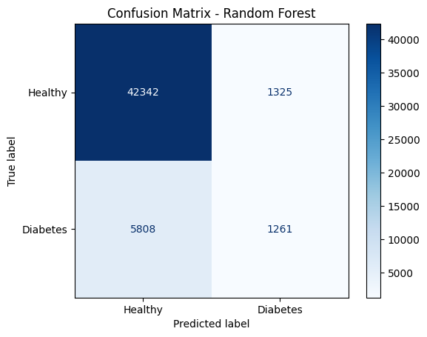
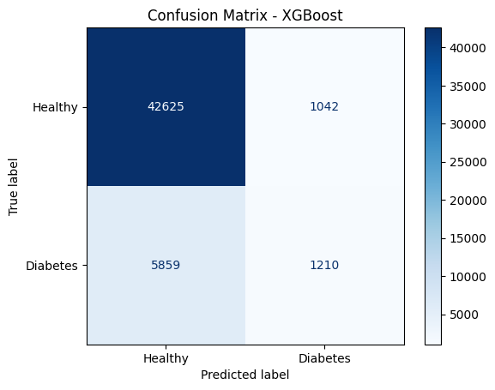
Confusion Matrix
P A R T 0 1

Slide 15
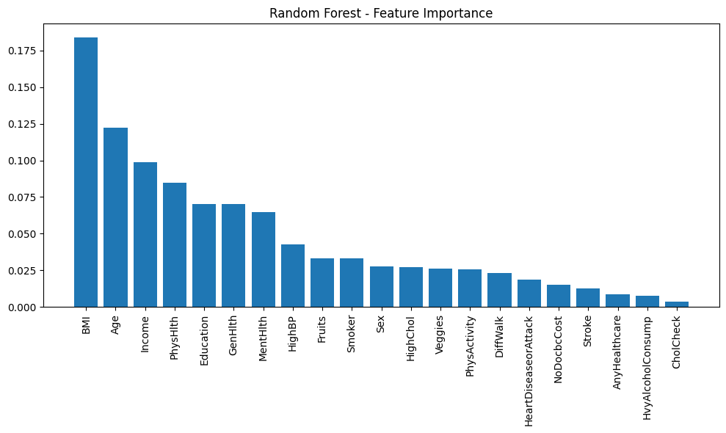
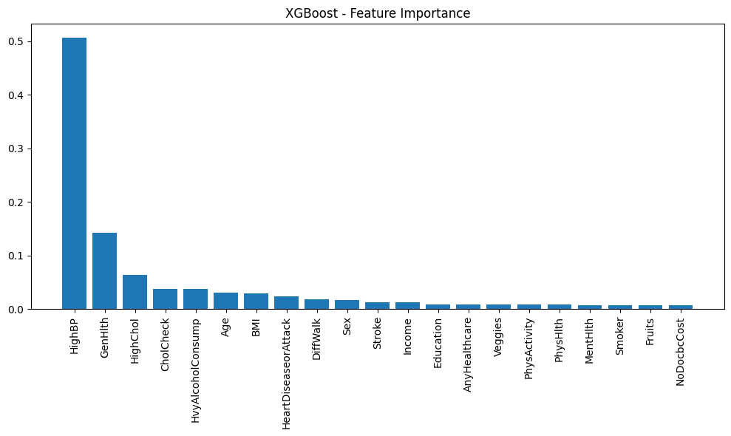
Feature Importance
P A R T 0 1
Notes:
BMI is most important for RF. HighBP is most important for XGBoost.

Slide 16
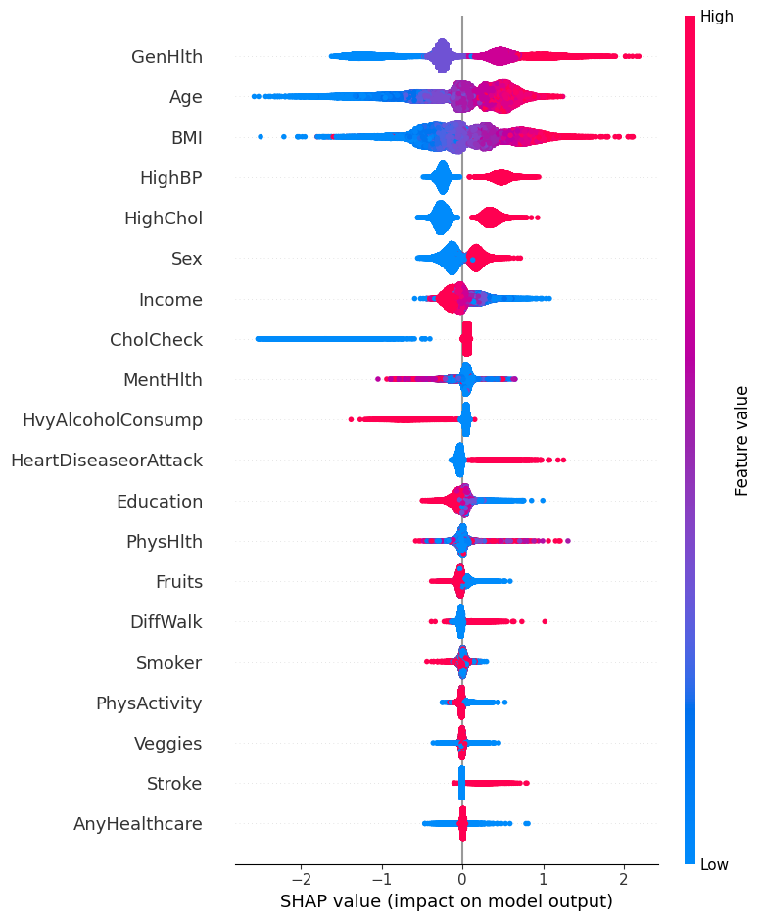
Shap
P A R T 0 1
Features contribution to prediction:
GenHealth
Age
BMI
Notes:
BMI is most important for RF. HighBP is most important for XGBoost.

Slide 17
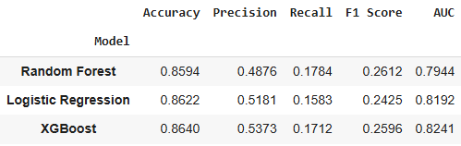
Performance Comparison Table
P A R T 0 1

Slide 18
Demo: AI Healthcare diagnosis chatbot
P A R T 0 1

Slide 19
Next steps
P A R T 0 1
Link the chat interface to the Disease Prediction model result
Finetune models on Medical images and disease datasets

